Slide 1
God’s Family, God’s Government
God’s Order
Ludwig
18/11/18

Slide 2
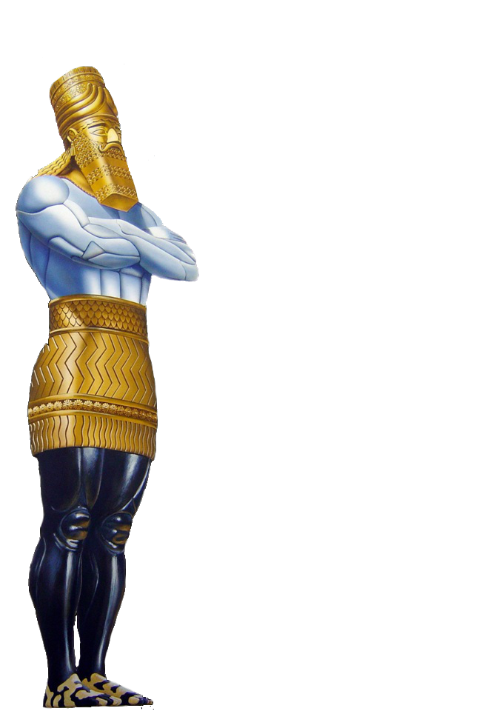


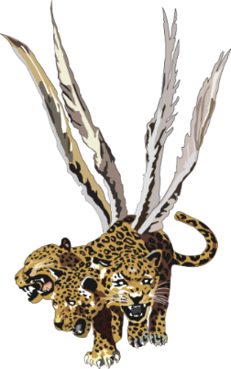
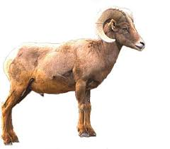
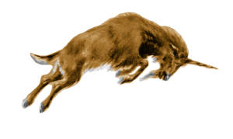


World Kingdoms
Daniel 2
(Metallic Kingdoms of the World)
WORLD
KINGDOMS
Daniel 7
(Beast Kingdoms of the world)
Daniel 8
GOLD
BABYLON
(Iraq)
LION
had eagle's wings
MEDO-PERSIA
(Iran)
SILVER
BEAR
- had 3 ribs
Ram
BRASS
LEOPARD
- have 4 wings of a fowl
- also had four heads
GREECE
He-Goat
LEGS OF IRON
ROME
TERRIBLE BEAST
- Dreadful & terrible
- had ten horns
10 TOES
IRON & CLAY
10 Kings
|
ANTI-CHRIST
10 HORNS
& LITTLE HORN

Slide 3
Who is above all?
Who is in us?
Who is above/over us?
Who is with us?
Who is for us?

Slide 4
God Sets Me Into His Family/Church
The Church:
God set the members
God composes the body
God appoints (Spiritual Parents, leaders)

Slide 5
1. Who Is Above All?
Colossians 1:15-18
¹⁵ He is the image of the invisible God, the firstborn over all creation.
¹⁶ For by Him all things were created that are in heaven and that are on earth, visible and invisible, whether thrones or dominions or principalities or powers. All things were created through Him and for Him.
¹⁷ And He is before all things, and in Him all things consist.
¹⁸ And He is the head of the body, the church, who is the beginning, the firstborn from the dead, that in all things He may have the pre-eminence.

Slide 6
Ephesians 4:4-6
⁴ There is one body and one Spirit, just as you were called in one hope of your calling;
⁵ one Lord, one faith, one baptism;
⁶ one God and Father of all, who is above all, and through all, and in you all.

Slide 7
Acts 17:22-26
²² Then Paul stood in the midst of the Areopagus and said, “Men of Athens, I perceive that in all things you are very religious;
²³ for as I was passing through and considering the objects of your worship, I even found an altar with this inscription:
TO THE UNKNOWN GOD.
Therefore, the One whom you worship without knowing, Him I proclaim to you:

Slide 8
²⁴ God, who made the world and everything in it, since He is Lord of heaven and earth, does not dwell in temples made with hands.
²⁵ Nor is He worshiped with men’s hands, as though He needed anything, since He gives to all life, breath, and all things.
²⁶ And He has made from one blood every nation of men to dwell on all the face of the earth, and has determined their preappointed times and the boundaries of their dwellings,

Slide 9
Ephesians 6:1-2
¹Children, obey your parents in the Lord, for this is right.
² “Honor your father and mother,” which is the first commandment with promise:

Slide 10
2. Who is in us?
Christ in us, the Hope of Glory
The incorruptible Seed in us
Temple for the Holy Spirit
Forming the nature and character of Christ

Slide 11
1 Peter 1:22-25
²² Since you have purified your souls in obeying the truth through the Spirit in sincere love of the brethren, love one another fervently with a pure heart,
²³ having been born again, not of corruptible seed but incorruptible, through the word of God which lives and abides forever,
²⁴ because
“All flesh is as grass,
And all the glory of man as the flower of the grass.
The grass withers,
And its flower falls away,
²⁵ But the word of the Lord endures forever.”

Slide 12
3. Who is above/over us?
Those whom God appoints over our lives

Slide 13
1 Peter 5:1-11
¹ The elders who are among you I exhort, I who am a fellow elder and a witness of the sufferings of Christ, and also a partaker of the glory that will be revealed:
² Shepherd the flock of God which is among you, serving as overseers, not by compulsion but willingly, not for dishonest gain but eagerly;
³ nor as being lords over those entrusted to you, but being examples to the flock;
⁴ and when the Chief Shepherd appears, you will receive the crown of glory that does not fade away.
Submit to God, Resist the Devil

Slide 14
⁵ Likewise you younger people, submit yourselves to your elders. Yes, all of you be submissive to one another, and be clothed with humility, for
“God resists the proud,
But gives grace to the humble.”
⁶ Therefore humble yourselves under the mighty hand of God, that He may exalt you in due time, ⁷ casting all your care upon Him, for He cares for you.

Slide 15
1 Timothy 5:17
¹⁷ Let the elders who rule well be counted worthy of double honor, especially those who labor in the word and doctrine.

Slide 16
Revelation 1:16-18
¹⁶ He had in His right hand seven stars, out of His mouth went a sharp two-edged sword, and His countenance was like the sun shining in its strength.
¹⁷ And when I saw Him, I fell at His feet as dead. But He laid His right hand on me, saying to me, “Do not be afraid; I am the First and the Last.
¹⁸ I am He who lives, and was dead, and behold, I am alive forevermore. Amen. And I have the keys of Hades and of Death.

Slide 17
¹⁹ Write the things which you have seen, and the things which are, and the things which will take place after this.
²⁰ The mystery of the seven stars which you saw in My right hand, and the seven golden lampstands: The seven stars are the angels of the seven churches, and the seven lampstands which you saw are the seven churches.

Slide 18
Note how the message to the seven churches are given to the stars of the churches
Example:
  Revelation 2:1“To the angel of the church of Ephesus write,…

Slide 19
1 Corinthians 4:15
¹⁵ For though you might have ten thousand instructors in Christ, yet you do not have many fathers; for in Christ Jesus I have begotten you through the gospel.

Slide 20
4. Who is with us?
They are those who are part of the same local church
Those who attend the same meetings
Judas?

Slide 21
5. Who is for us?
If one doesn’t agree, he disagrees
If you are not for, you are against
Daniel’s three friends stood together
Daniel and his three friends prayed together
No Misgivings, No Disloyalty

Slide 22
For the same faith
For the same Word
For the same call
For the same course
For the same cause
For the same convictions
For the same commitment

